Slide 1


Slide 2

Volunteers at Moorfields
Angela Smith

Slide 3

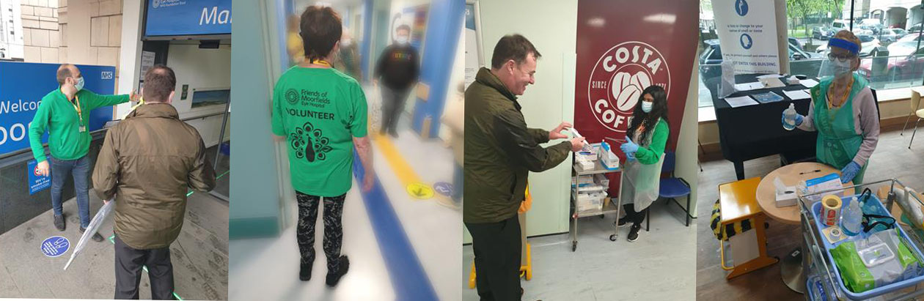

Volunteers returned to City Road from July 2020 to help Moorfields with it’s response to the pandemic.
More recently volunteers have returned to the network sites.

Slide 4

Current Volunteer Roles:
Queue Management
Meeting and Greeting
Wayfinding
Clinic Support
Wards and Theatres
Pharmacy
A&E Admin
Supporting Digital Inclusion
Health Information Hub
Chaperone Service
Peer to Peer Support
The Friends Shop

Slide 5
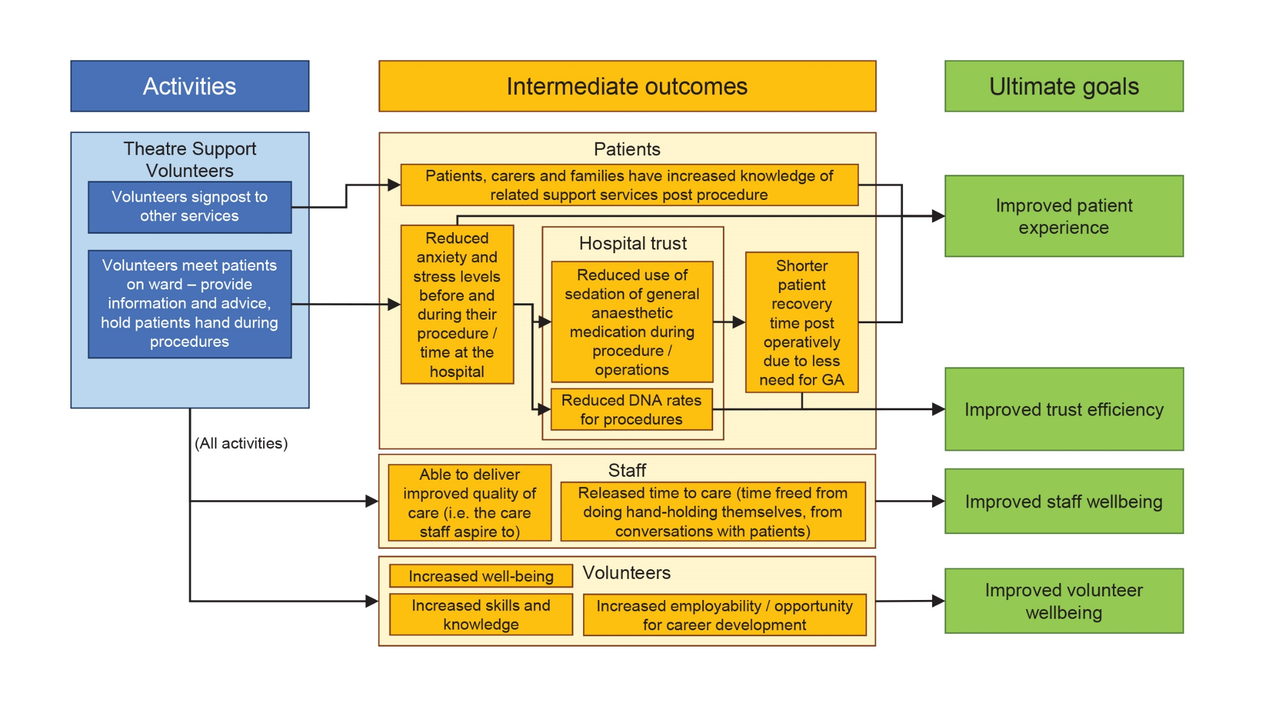
Theatre and Ward Support Volunteers:
Theory of Change

Slide 6
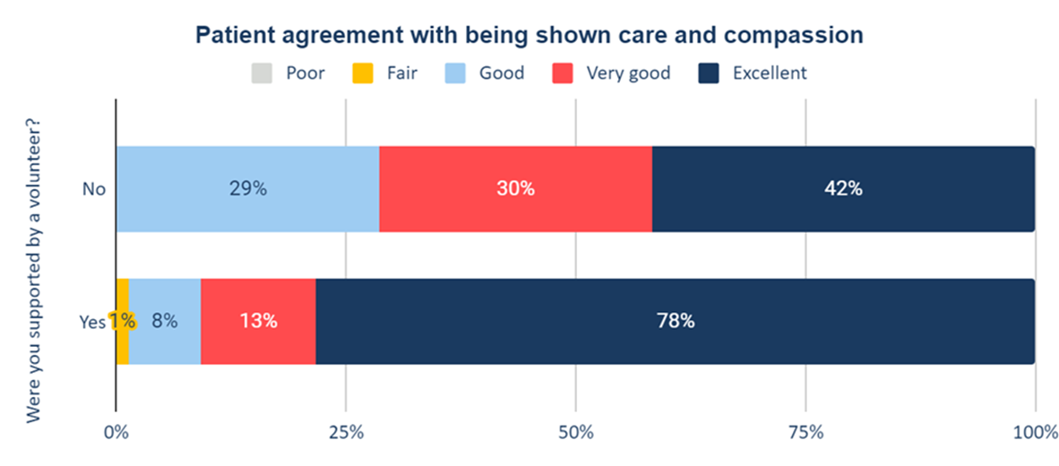
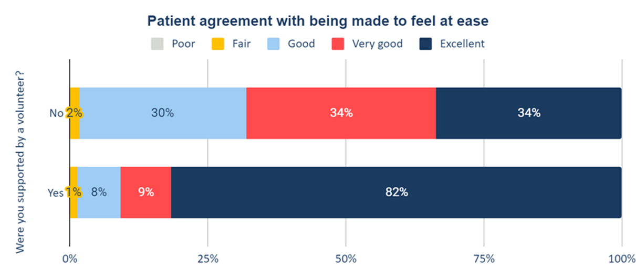

Slide 7
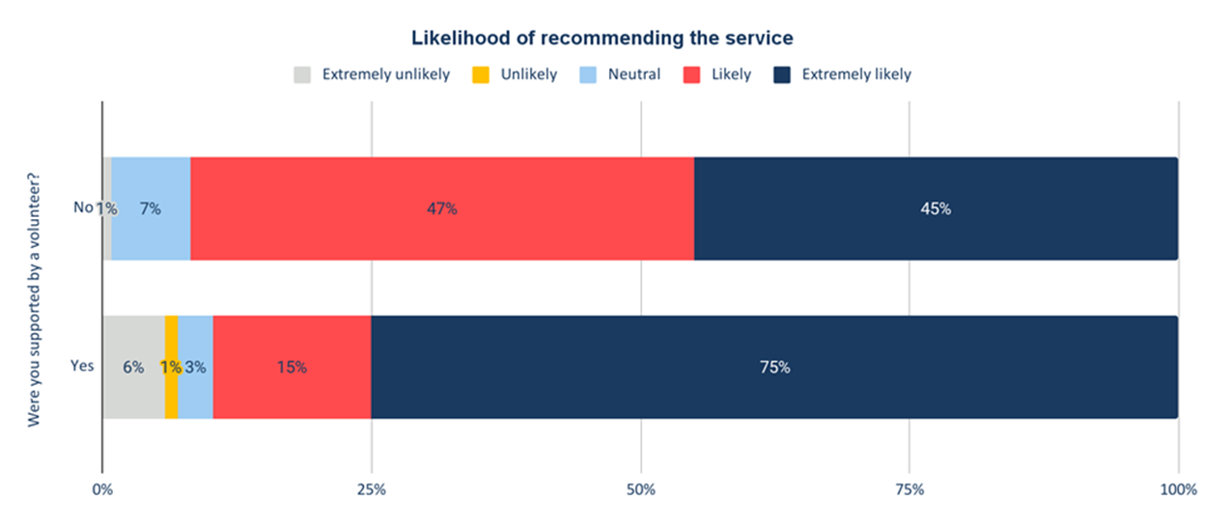
“Theatre support volunteers have been an invaluable addition to the operating theatre team bringing much valued reassurance and a friendly face for patients. The patients were noticeably more relaxed and the whole theatre team was able to really focus on their work safe in the knowledge that someone was there to help calm the patient and allay their fears without being distracted by needing to focus on the medical processes, surgery itself etc. ”
Professor Gus Gazzard MBBChir MA MD FRCOphth
Director, Glaucoma Service, Moorfields Eye Hospital

Slide 8


Volunteer to Career Project:
We have been awarded £25K from NHS Health Education England for a project called ‘Volunteer to Career’ which is to support volunteers considering a career in the NHS.

Slide 9

Support of the trust executive team.
Engagement with Workforce, Organisational Development and Volunteer Service teams.
Steering Group formed.
Communication with Senior clinicians and other relevant staff.
Expression of Interest received
Initial interview of interested volunteers
Meeting with clinicians and other staff supporting the project.
Select and match volunteers into placements.
Volunteers sign VtoC agreement
Conclusion
and Evaluation
Placement
Planing
Recruitment
Volunteer
To
Career
Application and Interview skills training.
Vacancies and Apprenticeship opportunities identified.
Final project staff and volunteer surveys completed.
Evaluation report presented
Start of project interview with selected volunteers.
Project promoted..
Placements start and additional opportunities identified.
Interview wit volunteers at 3, 6, 9 and 12 months
Application and interview skills training offered

Slide 10
What the volunteers say:
“This is the best decision I ever made. Helping people and giving back to the community is something everyone should do. For me it made me the person I am today. More responsible, confident and caring.”
“I love being part of the Friends of Moorfield's volunteering team. It means the world to me to be able to help patients and staff alike. Also, I have loved speaking to and reassuring so many patients during the pandemic. Moorfields is a wonderful hospital, and it is an honour to be a small part of it.”
“It is so rewarding to be able to help patients who feel anxious about coming to hospital, whether it is help them find their clinic, or hold their hand in an operation. I remember how alone and anxious I felt, so being able to support someone makes the world a little smaller and happier.”
““I love my voluntary role at Moorfields Potters Bar. It is a small and friendly unit and the patients and staff are always so grateful which in itself is very rewarding. It is interesting to chat to so many different people and I always come away very happy in the knowledge that I have spent a fulfilling few hours as a volunteer.”

Slide 12


